Slide 1


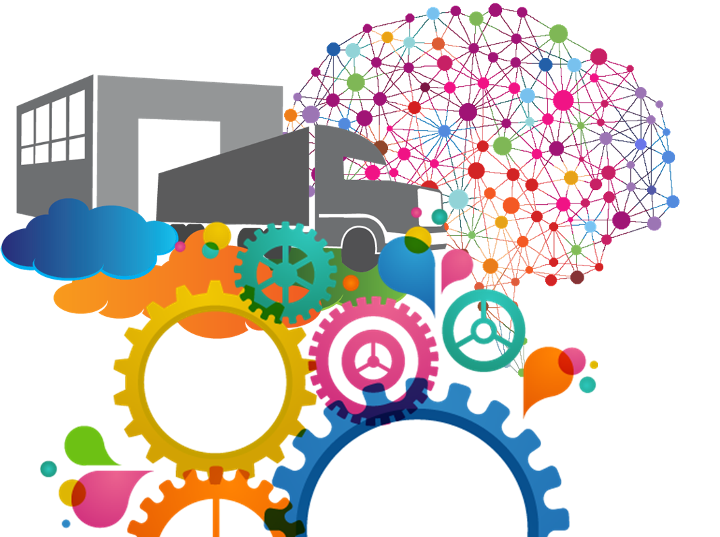
104KM Enterprise Information Systems
Recommended Reading`
Elmasri, R. and Navathe, S. (2016)
Fundamentals of Database Systems, Global Edition. Pearson Education Limited
Korth, H., Sudarshan, S., and Abraham Silberschatz, P. (2010)
Database System Concepts. McGraw-Hill Education
Roger S. Pressman
Software Engineering: A Practitioner's Approach 8th Edition

Slide 2

Assessments
Coursework(50%)
Phase test 1 (10%)
Phase test 2 (10%)
Activity Led Project Viva + (30%)
Exam (50%)
2-hour Exam

Slide 3
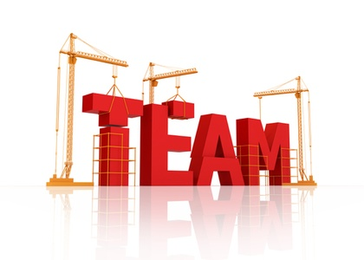

Group work
We Reserve the right to
Place people in any group ☺

Slide 4

All these need Project Managing

Slide 5

Your choices
Buy new software (Microsoft office suite ), Oracle , SAP
Amend software in the company
Create new software

Slide 6
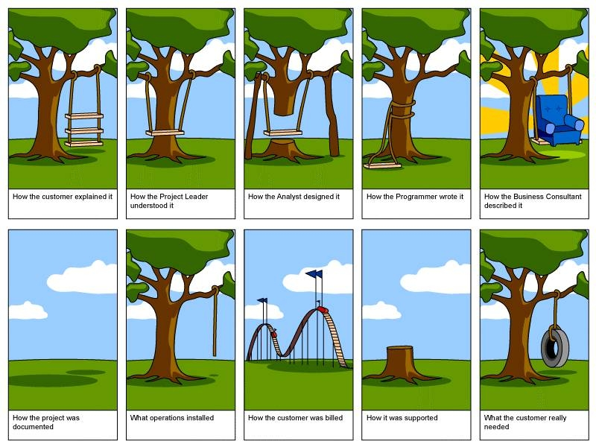
dEVELOPMENT GOING WRONG

Slide 7


If you don’t use SDLC
If you do then
Notes:
If you don’t use a SDLC - A ball of string grows and becomes difficult to unravel
If you do - Designed well, capacity to grow, well presented, captures requirements

Slide 8
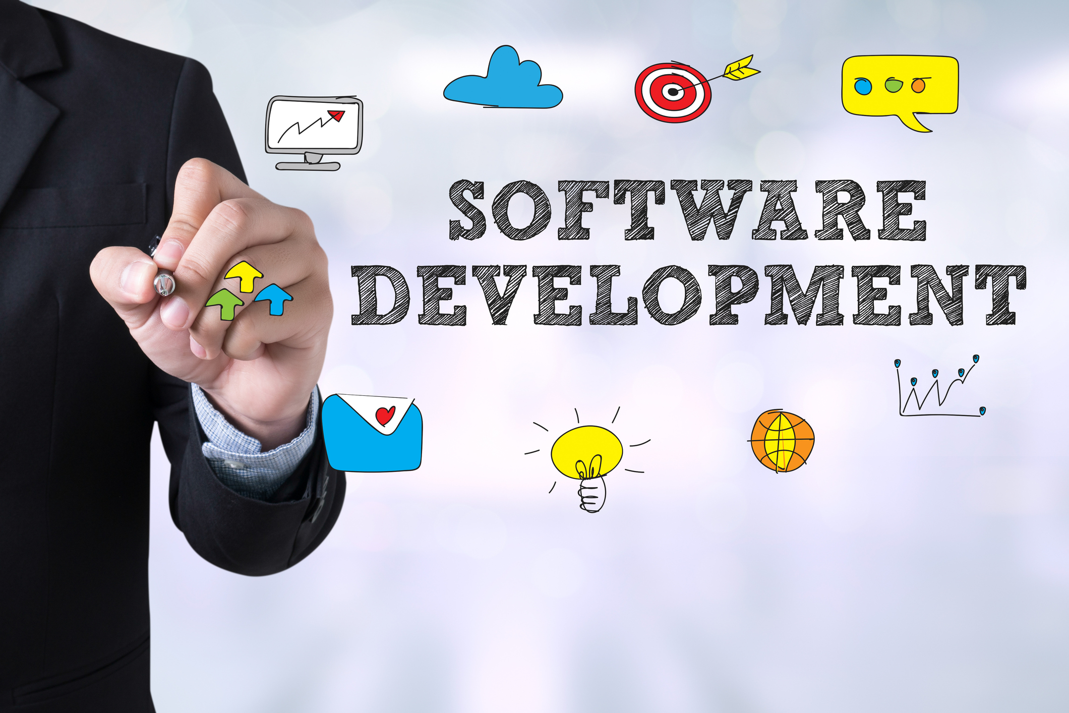
Life Cycles
“If you fail to plan, you are planning to fail.” – Benjamin Franklin

Slide 9
Software Development Life Cycle (SDLC) is a process used by the software industry to design, develop and test high quality software. The SDLC aims to produce a high-quality software that meets or exceeds customer expectations, reaches completion within times and cost estimates. SDLC is a process which defines the various stages involved in the development of software for delivering a high-quality product. SDLC stages cover the complete life cycle of a software i.e. from inception to retirement of the product. Traditionally, each step creates an output–whether an idea, document, diagram, or piece of working software–which is then used as the input for the next step. And so on until you hit your goal. That being said, software is never really “finished.” Even the release of your first version can be seen as just another step in the lifecycle of your software. Adhering to the SDLC process leads to the development of the software in a systematic and disciplined manner.

Slide 10
Purpose:
Purpose of SDLC is to deliver a high-quality product which is as per the customer’s requirement.
SDLC has defined its phases as, Requirement gathering, Designing, Coding, Testing, and Maintenance. It is important to adhere to the phases to provide the Product in a systematic manner.

Slide 11
Why SDLC?
It offers a basis for project planning, scheduling, and estimating
Provides a framework for a standard set of activities and deliverables
It is a mechanism for project tracking and control
Increases visibility of project planning to all involved stakeholders of the development process
Increased and enhance development speed
It ensures correct and timely delivery to the client.
Improved client relations
Helps you to decrease project risk and project management plan overhead

Slide 12
Requirement analysis
All the relevant information is collected from the customer to develop a product as per their expectation. Any ambiguities must be resolved.
Project manager and Business analyst set up a meeting with the customer to gather all the information. Before building a product a core understanding or knowledge of the product is very important
This stage gives a clearer picture of the scope of the entire project and the anticipated issues, opportunities, and directives which triggered the project.
Requirements Gathering stage need teams to get detailed and precise requirements. This helps companies to finalize the necessary timeline to finish the work of that system.
All stakeholders in a project - developers, end users, software managers, customer managers - must achieve a common understanding of what the product will be and do, or someone will be surprised when it is delivered. Surprises in software are almost never good news

Slide 13
Activities for Requirement Analysis
Requirements analysis is critical to the success or failure of a systems or software project. The requirements should be documented, actionable, measurable, testable, traceable, related to identified business needs or opportunities, and defined to a level of detail sufficient for system design. Conceptually, requirements analysis includes four types of activity:
Eliciting requirements: the task of communicating with customers and users to determine what their requirements are. This is sometimes also called requirements gathering.
Analyzing requirements: determining whether the stated requirements are unclear, incomplete, ambiguous, or contradictory, and then resolving these issues.
Requirements modeling: Requirements might be documented in various forms, such as natural-language documents, use cases, user stories, or process specifications.
Review and retrospective: Team members reflect on what happened in the iteration and identifies actions for improvement going forward.

Slide 14
Feasibility study
This process conducted with the help of 'Software Requirement Specification' document also known as 'SRS' document. It includes everything which should be designed and developed during the project life cycle.
There are mainly five types of feasibilities checks:
EconomiC: Can we complete the project within the budget or not?
ORGANIZATIONAL: Can the project be handled consistently with the company policies/objectives?
Operation feasibility: Can we create operations which is expected by the client?
Technical: Need to check whether the current computer system can support the software
Schedule: Decide that the project can be completed within the given schedule or not.

Slide 15
DESIGN
SRS (Software Requirement Specification) is the reference document used in this phase for the product to be developed. System and software design documents are prepared as per the specification document
Two kinds of design documents are prepared in this phase:
High-Level Design (HLD)-High-level Design is the overall system design, covering the details at macro level.
Low- Level Design (LLD)-Low-Level Design is like detailing the HLD, a micro level design document.
High-Level Design (HLD)
Brief description and name of each module
BRIEF functionality of every module
Interface relationship and dependencies between modules
Database tables identified along with their key elements
Complete architecture diagrams along with technology details (data flow, flowcharts)

Slide 16
DESIGN
Low-Level Design(LLD)
Functional logic of the modules
Database tables, which include type and size
Complete detail of the interface
Addresses all types of dependency issues
Listing of error messages
Complete input and outputs for every module
The design is usually kept in the Design Specification Document (DSD)

Slide 17
CODING
The Software design is translated into source code.
In this phase, developers start build the entire system by writing code using the chosen programming language
In the coding phase, tasks are divided into units or modules and assigned to the various developers
PEER REVIEW

Slide 18
TESTING
The testing team starts testing the functionality of the entire system. This is done to verify that the entire application works according to the customer requirement.
During this phase, QA and testing team may find some bugs/defects which they communicate to developers.
The development team fixes the bug and send back to QA for a re-test. This process continues until the software is bug-free, stable, and working according to the business needs of that system.

Slide 19
INSTALLATION/DEPLOYMENT
Once the software testing phase is over and no bugs or errors left in the system then the final deployment process starts. Based on the feedback given by the project manager, the final software is released and checked for deployment issues if any.
Once the product is tested, it is deployed in the production environment or first UAT (User Acceptance testing) is done depending on the customer expectation.
In the case of UAT, a replica of the production environment is created and the customer along with the developers does the testing.
If the customer finds the application as expected, then sign off is provided by the customer to go live.

Slide 20
maintenance
After the deployment of a product on the production environment, maintenance of the product i.e. if any issue comes up and needs to be fixed or any enhancement is to be done is taken care by the developers.
Bug fixing - bugs are reported because of some scenarios which are not tested at all
Upgrade - Upgrading the application to the newer versions of the Software
Enhancement - Adding some new features into the existing software

Slide 21
Choosing a methodology
Issues to consider
Who are the stakeholders?
What type of system is being developed?
What are the principal features of the environment in which the system(s) is to be developed? ( Most difficult to address)
Long term/ Short term
Notes:
Environment – Cultural and social aspects, tools to support development, constraints eg. Money and time and the nature of the existing system.

Slide 22
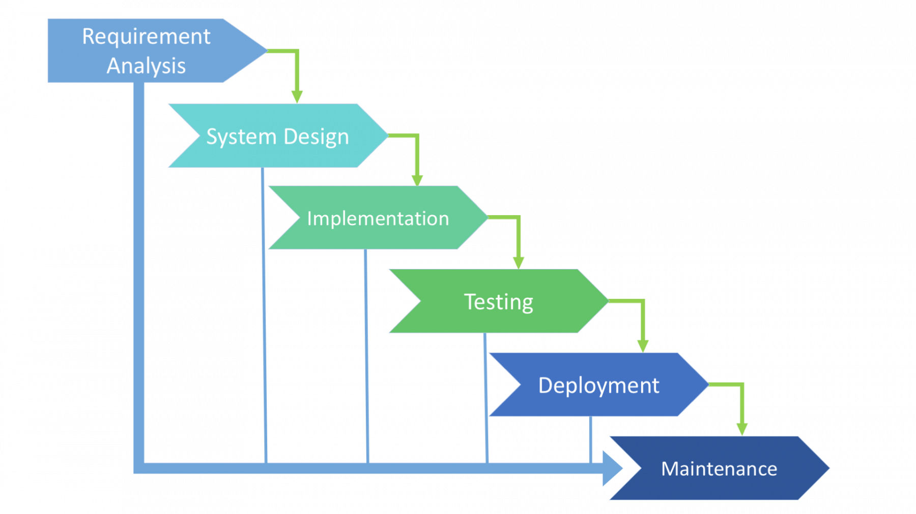
Waterfall
It is also known as the linear sequential model.
In this model, the outcome of one phase is the input for the next phase. Development of the next phase starts only when the previous phase is complete.
In this waterfall model, the phases do not overlap.

Slide 23
Waterfall, when?
Requirements are very well documented, clear and fixed.
There are no ambiguous requirements.
Ample resources with required expertise are available freely.
The client has high confidence in the organization.
The organization has experience of similar projects.
The project is short.
It is good to use this model when the technology is well understood.

Slide 24
Waterfall – Pros & Cons
Simple and easy to understand and use
Works well for smaller projects where requirements are very well understood.
Clearly defined stages and well understood milestones.
No working software is produced until late during the life cycle.
High amounts of risk and uncertainty.
Not a good model for complex and object-oriented projects.
Not suitable for the projects where requirements are at a moderate to high risk of changing.
Cannot accommodate changing requirements.
Integration is done as a "big-bang. at the very end, which doesn't allow identifying any technological or business bottleneck or challenges early.
Waterfall model is time-consuming

Slide 25
Waterfall with Iteration
Feasibility
Same structure as Waterfall approach plus:
Iteration within stages until criteria satisfied
More able to manage non-sequential projects
Able to consider bottlenecks and changes in advance
Requirements Analysis
Design
Construction
Testing
Installation
Maintenance

Slide 26
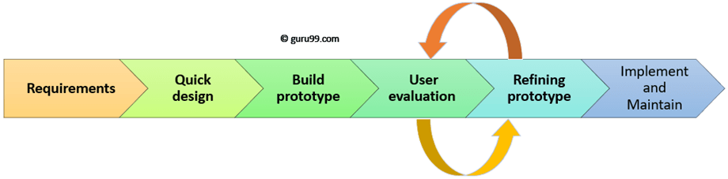
Prototype Model
Prototype is a working model of software with some limited functionality
The prototype model is a model in which the prototype is developed prior to the actual software.
Prototype models have limited functional capabilities and inefficient performance when compared to the actual software.
Dummy functions are used to create prototypes. This is a valuable mechanism for understanding the customers’ needs.
Software prototypes are built prior to the actual software to get valuable feedback from the customer.
Feedbacks are implemented and the prototype is again reviewed by the customer for any change. This process goes on until the model is accepted by the customer.

Slide 27
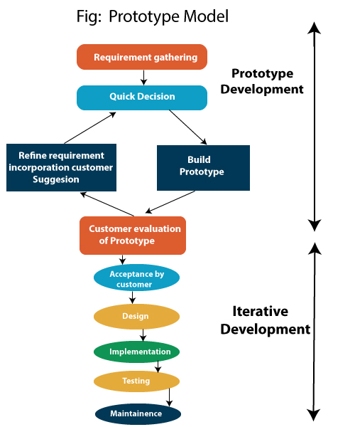
Prototype model

Slide 28
Prototype Model
Requirements gathering and analysis-In this phase, the requirements of the system are defined in detail. During the process, the users of the system are interviewed to know what is their expectation from the system.
Quick design-In this stage, a simple design of the system is created. However, it is not a complete design. It gives a brief idea of the system to the user.
Build a Prototype-In this phase, an actual prototype is designed based on the information gathered from quick design. It is a small working model of the required system
Initial user evaluation-In this stage, the proposed system is presented to the client for an initial evaluation. It helps to find out the strength and weakness of the working model. Comment and suggestion are collected from the customer and provided to the developer.
Refining prototype-If the user is not happy with the current prototype, you need to refine the prototype according to the user's feedback and suggestions.
This phase will not over until all the requirements specified by the user are met. Once the user is satisfied with the developed prototype, a final system is developed based on the approved final prototype.
Implement Product and Maintain-Once the final system is developed based on the final prototype, it is thoroughly tested and deployed to production.
.

Slide 29
Software Prototyping – Pros & Cons
Improved understanding between Client/Developer/User
Catch ‘missed’ requirements
Easier to change existing requirements / add new requirements
Potential problems identified at an early stage
Functionality
Usability
Interface
Progressively build up confidence in what the system can /can’t do
Client/User may not understand that iterations are only prototypes
Expect ‘early’ delivery
Expect reduced cost
Add extra requirements
May divert attention from functional to interface issues
Prototypes require significant Client/User involvement
Co-ordination of activities requires careful planning and management
The effort invested in building prototypes may be too much if it is not monitored properly
Users may get confused in the prototypes and actual systems.

Slide 30
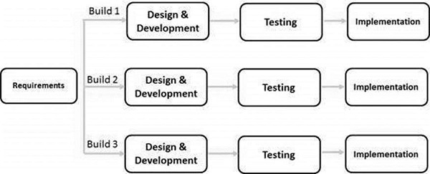
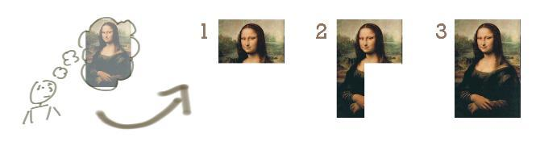
incremental

Slide 31
iNCREMENTAL
INITIALLY ALL THE REQUIREMENTS ARE CLEARLY SPECIFIED AND STABLE.
IN EACH BUILD (CYCLE/INCREMENT), A ASUBSET OF REQUIREMENTS IS DELIVERED.
PART OF FUNCTIONALITY IS DELIVERED IN EACH ITERATION.
SECOND BUILD MAY START AFTER THE FIRST BUILD COMPLETED OR SOME PART OF FIRST BUILD COMPLETED
SECOND BUILD CONTAINS ADDITIONAL FUNCTIONALITIES THAN FIRST AND SO ON.
THE MOST IMPORTANT REQUIREMENTS (Priority) ARE DELIVERED IN FIRST BUILD THAN SECOND AND SO ON.
Each cycle delivers semi completed product with limited functionalities.
Last cycle results the complete product.

Slide 32
When we use the Incremental Model?
When the requirements are superior.
A project has a lengthy development schedule.
When Software team are not very well skilled or trained.
When the customer demands a quick release of the product.
You can develop prioritized requirements first.

Slide 33
Incremental Pros & Cons
Errors are easy to be recognized.
Easier to test and debug
More flexible.
Simple to manage risk because it handled during its iteration.
The Client gets important functionality early.
Need for good planning
Total Cost is high.
Well defined module interfaces are needed.

Slide 34
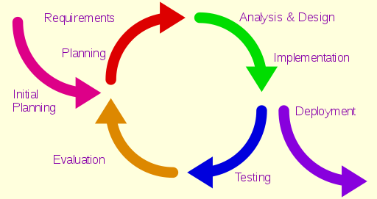
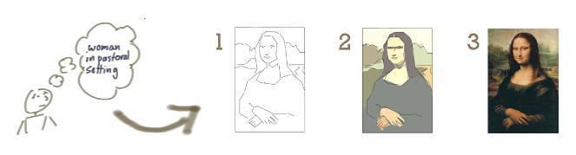
ITERATIVE
When to use the Iterative Model?
When requirements are defined clearly and easy to understand.
When the software application is large.
When there is a requirement of changes in future.

Slide 35
iterative
In this Model, you can start with some of the software specifications and develop the first version of the software
After the first version if there is a need to change the software, then a new version of the software is created with a new iteration
Every release of the Iterative Model finishes in an exact and fixed period that is called iteration.
The final output of the project renewed at the end of the Software Development Life Cycle (SDLC) process.

Slide 36
Iterative Pros & Cons
Testing and debugging during smaller iteration is easy.
It is easily acceptable to ever-changing needs of the project.
Risks are identified and resolved during iteration.
Limited time spent on documentation and extra time on designing.
It is not suitable for smaller projects.
More Resources may be required.
Design can be changed again and again because of imperfect requirements.
Requirement changes can cause over budget.
Project completion date not confirmed because of changing requirements.

Slide 37
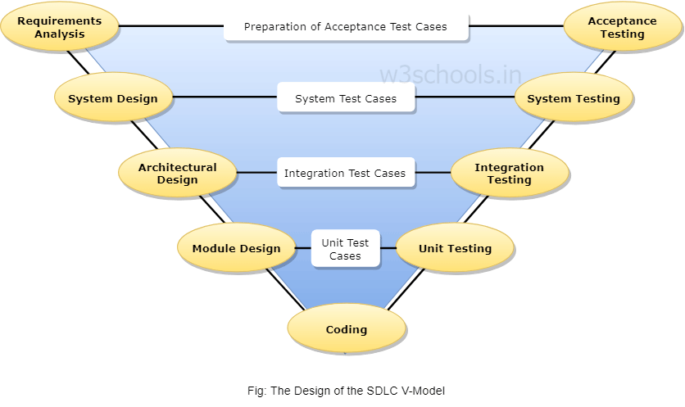
V-Shaped Model
V- Model is also known as Verification and Validation Model
The V-Model is an extension of the waterfall model and is based on the association of a testing phase for each corresponding development stage.
This means that for every single phase in the development cycle, there is a directly associated testing phase.

Slide 38
V-model
In parallel to the software development phase, a corresponding series of test phase also runs in this model. Each stage comprises a specific type of testing done, and once that testing is passed, only then the next phase starts.
Unit Testing: During the development of module design, unit testing is carried out. This plan is executed for eliminating bugs that are found in code at the development of your software.
Integration Testing: Once the unit testing is done, the integration testing is carried out where the integration of modules in the system is hardened. This testing is done in the architecture design phase.
System Testing: This ultimate test is done when the entire product is completed in conjunction with the functionality, internal dependency requirement and merging of different modules into a single unit.
User Acceptance Testing: This type of testing is carried out in front of the user or in a user environment where the product will ultimately set up. The UAT particularly test whether the product is capable enough to launch in the market or ready to work in the real world.

Slide 39
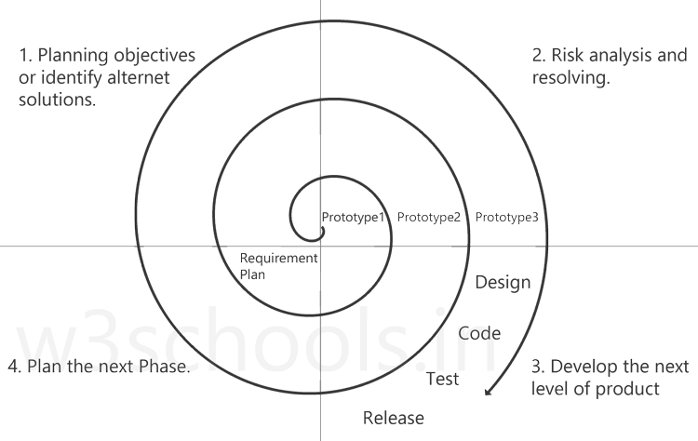
Spiral model

Slide 40
Spiral model
Planning objectives or identify alternative solutions: In this stage, requirements are collected from customers and then the aims are recognized, elaborated as well as analyzed at the beginning of developing the project. If the iterative round is more than one, then an alternative solution is proposed in the same quadrant.
Risk analysis and resolving: As the process goes to the second quadrant, all likely solutions are sketched, and then the best solution among them gets select. Then the different types of risks linked with the chosen solution are recognized and resolved through the best possible approach. As the spiral goes to the end of this quadrant, a project prototype is put up for the most excellent and likely solution.

Slide 41
Spiral model
Develop the next level of product: As the development progress goes to the third quadrant, the well-known and mostly required features are developed as well as verified with the testing methodologies. As this stage proceeds to the end of this third quadrant, new software or the next version of existing software is ready to deliver.
Plan the next Phase: As the development process proceeds in the fourth quadrant, the customers appraise the developed version of the project and reports if any further changes are required. At last, planning for the subsequent phase is initiated.

Slide 42
Spiral model-advantages
Suitable for large projects: Spiral models are recommended when the project is large, bulky or complex to develop.
Risk Handling: There are a lot of projects that have un-estimated risks involved with them. For such projects, the spiral model is the best SDLC model to pursue because it can analyze risk as well as handling risks at each phase of development.
Customer Satisfaction: Customers can witness the development of product at every stage and thus, they can let themselves habituated with the system and throw feedbacks accordingly before the final product is made.
Requirements flexibility: All the specific requirements needed at later stages can be included precisely if the development is done using this model.

Slide 43
Spiral Pros & Cons
High amount of risk analysis hence, avoidance of Risk is enhanced
Good for large and mission-critical projects.
Additional Functionality can be added at a later date.
Software is produced early in the software life cycle.
The cost can be high as it might take a large number of iterations which can lead to high time to reach the final product.
Risk analysis requires highly specific expertise.
Project’s success is highly dependent on the risk analysis phase.
Doesn’t work well for smaller projects.

Slide 44
Spiral-when to use?
When deliverance is required to be frequent.
01
When the project is large
02
When requirements are unclear and complex
03
When changes may require at any time
04
Large and high budget projects
05

Slide 45
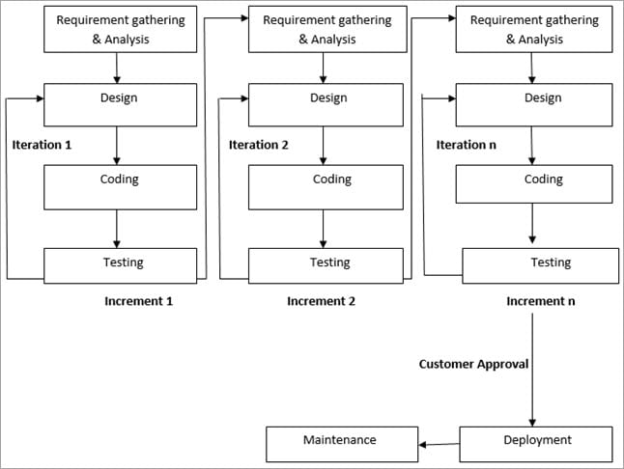
agile
Agile SDLC model is a combination of iterative and incremental process models with focus on process adaptability and customer satisfaction by rapid delivery of working software product

Slide 46
agile
In Agile, a product is broken into small incremental builds. It is not developed as a complete product in one go. Each build increments in terms of features. The next build is built on previous functionality.
In agile iterations are termed as sprints. Each sprint lasts for2-4 weeks. At the end of each sprint, the product owner verifies the product and after his approval, it is delivered to the customer.
Customer feedback is taken for improvement and his suggestions and enhancement are worked on in the next sprint. Testing is done in each sprint to minimize the risk of any failures.
The division of the entire project into smaller parts helps to minimize the project risk
Each iteration involves a team working through a full software development life cycle including planning, requirements analysis, design, coding, and testing before a working product is demonstrated to the client.
Iterative approach is taken and working software build is delivered after each iteration. Each build is incremental in terms of features; the final build holds all the features required by the customer.

Slide 47
Agile Manifesto principles
Individuals and interactions − In Agile development, self-organization and motivation are important, as are interactions like co-location and pair programming.
Working software − Demo working software is considered the best means of communication with the customers to understand their requirements, instead of just depending on documentation.
Customer collaboration − As the requirements cannot be gathered completely in the beginning of the project due to various factors, continuous customer interaction is very important to get proper product requirements.
Responding to change − Agile Development is focused on quick responses to change and continuous development.

Slide 48
Agile Pros & Cons
Customer satisfaction by rapid, continuous delivery of useful software.
People and interactions are emphasized rather than process and tools. Customers, developers and testers constantly interact with each other.
Working software is delivered frequently (weeks rather than months).
Face-to-face conversation is the best form of communication.
Close, daily cooperation between business people and developers.
Even late changes in requirements are welcomed
Continuous attention to technical excellence and good design.
Promotes teamwork and cross training.
In case of some software deliverables, especially the large ones, it is difficult to assess the effort required at the beginning of the software development life cycle.
There is lack of emphasis on necessary designing and documentation.
The project can easily get taken off track if the customer representative is not clear what final outcome that they want.
Transfer of technology to new team members may be quite challenging due to lack of documentation.
Due to the lack of proper documentation, once the project completes and the developers allotted to another project, maintenance of the finished project can become a difficulty.
Agile needs experienced and highly skilled resources.

Slide 49
Agile-when?
When frequent changes are required.
When a highly qualified and experienced team is available.
When a customer is ready to have a meeting with a software team all the time.
Unlike the waterfall model in agile model very limited planning is required to get started with the project. Agile assumes that the end users’ needs are ever changing in a dynamic business and IT world. Changes can be discussed and features can be newly effected or removed based on feedback.
There is no limit to the budget and timing, or when their estimation of budget and timing is simply not possible (relevant for startups).
The consumer needs to quickly launch the product and commercialize it.

Slide 50
Agile Methodologies
eXtreme programming
SCRUM
Agile Modeling
Adaptive Software Development
Crystal
Dynamic Systems Development Methods (DSDM)
Feature Driven Development (FDD)
Lean software development
Notes:
Extreme Programming: Concentrates on the development rather than managerial aspects of a software development process
Scrum: Unlike XP considers both managerial and development aspects of software development process

Slide 51
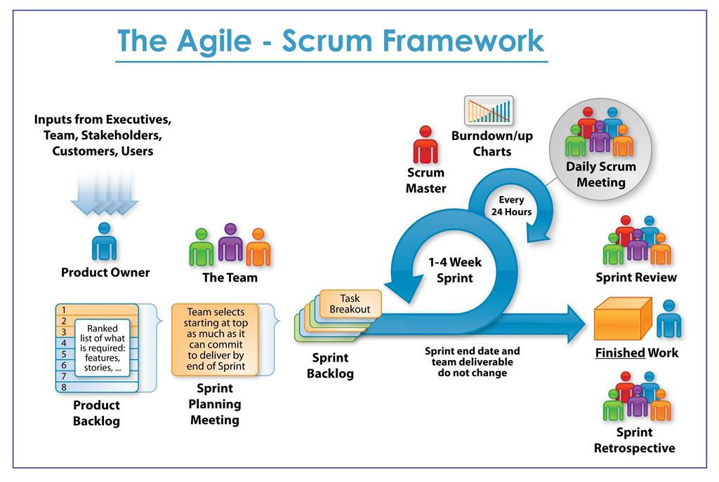

Slide 52
The Scrum Team
The Product Owner-a spokesperson for the customer. Product Owner who conveys the overall mission and vision of the product which the team is building. The Product Owner is ultimately accountable for managing the product backlog and accepting completed increments of work.
The ScrumMaster-a facilitator, the ScrumMaster ensures that the team adheres to Scrum theory, practices, and rules. he ScrumMaster protects the team by doing anything possible to help the team perform at the highest level. This may include removing impediments, facilitating meetings, and helping the Product Owner groom the backlog.
The Development Team-The Development Team is a self-organizing, cross-functional group armed with all of the skills to deliver shippable increments at the completion of each sprint.

Slide 53
SCRUM EVENTS
The Sprint-A sprint is a time-boxed period during which specific work is completed and made ready for review. Sprints are usually 2-4 weeks long but can be as short as one week
Sprint Planning Sprint-Planning team meetings are time-boxed events that determine which product backlog items will be delivered and how the work will be achieved.
The Daily Stand-up-The Daily Stand-up is a short communication meeting (no more than 15 minutes) in which each team member quickly and transparently covers progress since the last stand-up, planned work before the next meeting, and any impediments that may be blocking his or her progress.
The Sprint Review-The Sprint Review is the "show-and-tell" or demonstration event for the team to present the work completed during the sprint. The Product Owner checks the work against pre-defined acceptance criteria and either accepts or rejects the work. The stakeholders or clients give feedback to ensure that the delivered increment met the business need.
The Retrospective-The Retrospective, or Retro, is the final team meeting in the Sprint to determine what went well, what didn't go well, and how the team can improve in the next Sprint

Slide 54
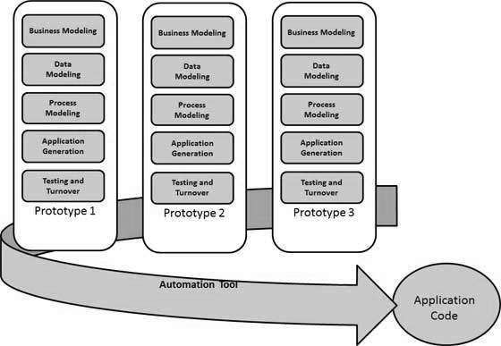
Rapid application development

Slide 55
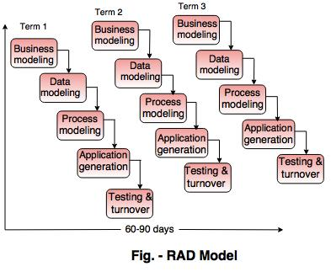
rad
It emphasizes on delivering projects in small pieces; the larger projects are divided into a series of smaller projects.
The main features of RAD model are that it focuses on the reuse of templates, tools, processes, and code.
Using the RAD model, software product is developed in a short period of time.

Slide 56
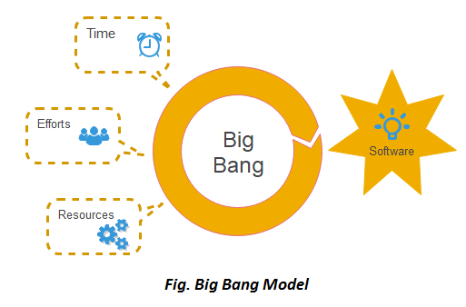
Big bang
In this model, developers do not follow any specific process. Development begins with the necessary funds and efforts in the form of inputs. And the result may or may not be as per the customer's requirement, because in this model, even the customer requirements are not defined.
This model is ideal for small projects like academic projects or practical projects. One or two developers can work together on this model.
This method is also used when the size of the developer team is small and when requirements are not defined, and the release date is not confirmed or given by the customer.

Slide 57
Big Bang Pros & Cons
There is no planning required.
Simple Model.
Few resources required.
Easy to manage.
Flexible for developers.
There are high risk and uncertainty.
Not acceptable for a large project.

